Slide 1
Syntax and Semantics of the Clock Constraint
刘骞
2018.11

Slide 2
contents
Major Considerations in System Modeling
Simple Modeling Language（SML）
Examples of SML
From SML Programs to Kripke Structures

Slide 3
Major Considerations in System Modeling

Slide 4
What should we consider ?
type of system
discrete(-time) systems continuous(-time) systems
concurrent processes ……………
Type of Property
Real-time properties（timed automaton）
Boolean properties（propositional temporal logic）
Modeling the Environment
Level of Abstraction
Clarity and Modularity
Form of Composition
Computational Engines
Practical Ease of Modeling and Expressiveness

Slide 5
Modeling Languages
Hardware description languages (HDLs).
General-purpose modeling languages(UML)
Architecture Description Languages (ADLs)
Simulation-oriented languages and tools
Reactive programming languages
Verification languages

Slide 6
Challenges in Modeling

Slide 7
Simple modeling language (SML)

Slide 8
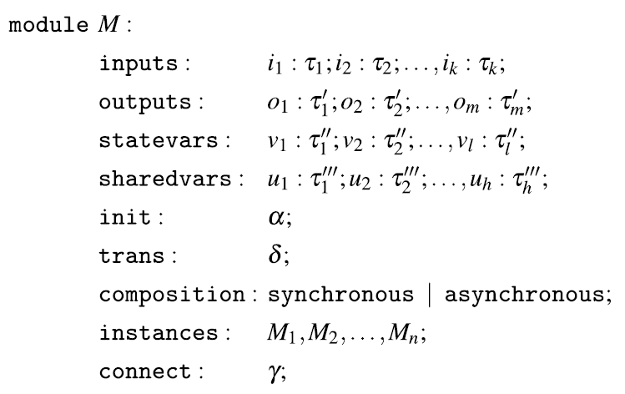
Syntax
A primitive module does not have the composition, sharedvars, instances, and connect sections .

Slide 9
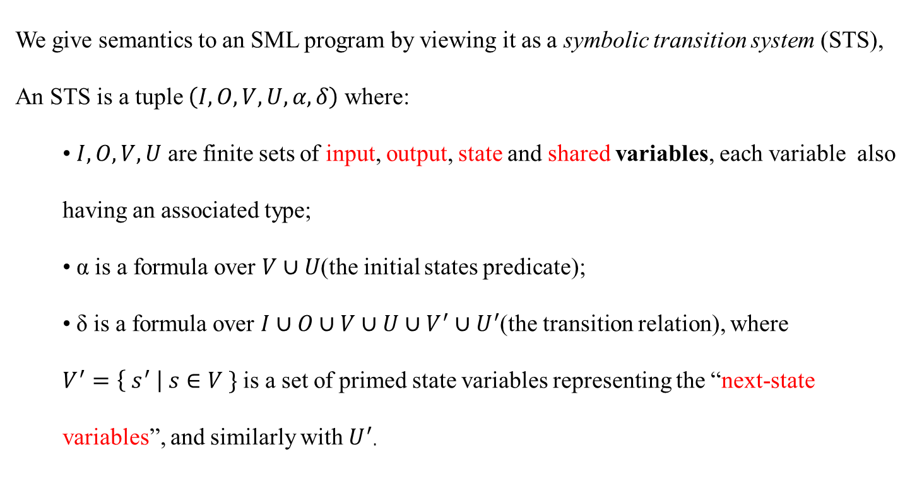
Semantics
We give semantics to an SML program by viewing it as a symbolic transition system (STS),
An STS is a tuple $\left(I,O,V,U,α,δ\right)$where:
• $I,O,V,U$ are finite sets of input, output, state and shared variables, each variable also having an associated type;
• α is a formula over $V∪U$(the initial states predicate);
• δ is a formula over $I∪O∪V∪U∪V^{′}∪U^{′}$(the transition relation), where
$V^{′}=\left\{ s^{′} \right| s∈V \}$ is a set of primed state variables representing the “next-state variables”, and similarly with $U^{′}$.

Slide 10

Semantics
If M is primitive, then
$STSM=(I,O,V,∅,α,δ)$
(the set of shared variables is empty).
If M is composite, then
$M=M_{1}∪M_{2}∪…∪M_{n}$,
and then
$STSsM=\left(Ii,Oi,Vi,∅i,αi,δi\right)$
for i = 1, . . . , n.

Slide 11
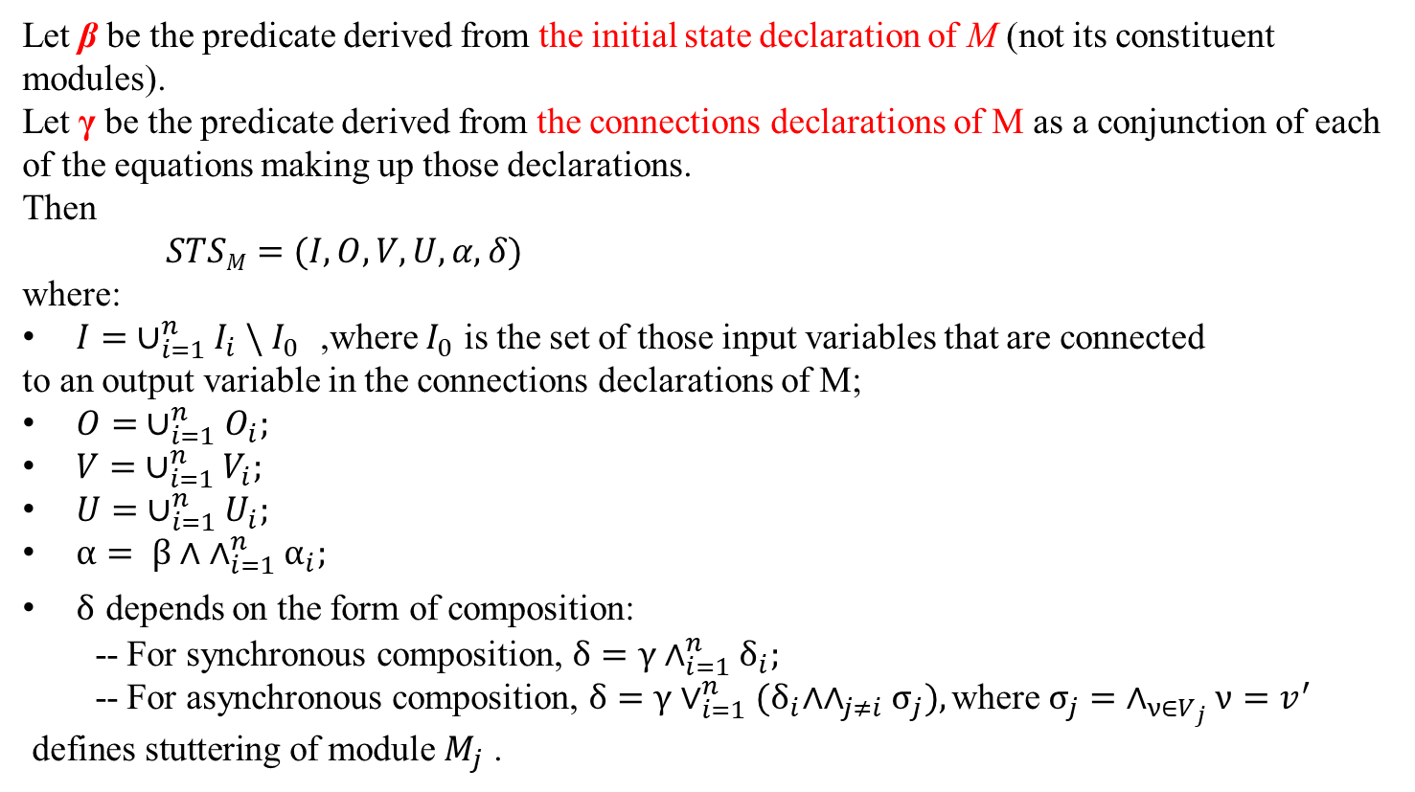
Semantics
Let β be the predicate derived from the initial state declaration of M (not its constituent modules).
Let γ be the predicate derived from the connections declarations of M as a conjunction of each of the equations making up those declarations.
Then
$STSM=(I,O,V,U,α,δ)$
where:
$I= ∪_{i=1}^{n}I_{i} \backslash I_{0}$ ,where $I_{0}$ is the set of those input variables that are connected
to an output variable in the connections declarations of M;
$O= ∪_{i=1}^{n}O_{i};$
$V= ∪_{i=1}^{n}V_{i};$
$U= ∪_{i=1}^{n}U_{i};$
$α= β∧ ∧_{i=1}^{n}α_{i};$
$δ$ depends on the form of composition:
-- For synchronous composition, $δ=γ∧_{i=1}^{n}δ_{i};$
-- For asynchronous composition, $δ=γ∨_{i=1}^{n}{(δ}_{i}∧∧_{j≠i}σ_{j}),\text{where}{ σ}_{j}=$ $∧_{ν∈V_{j}}ν=v^{′}$ $\text{defines} \text{stuttering} \text{of} \text{module}$ $M_{j}\text{ .}$

Slide 12
Modeling Concepts
Open and Closed Systems
Safety and Liveness
Fairness
Encapsulation
Moore and Mealy machines

Slide 13
Examples
A flit contains a 24-bit data payload, a 6-bit destination address, and a 2-bit type .
--

Slide 14
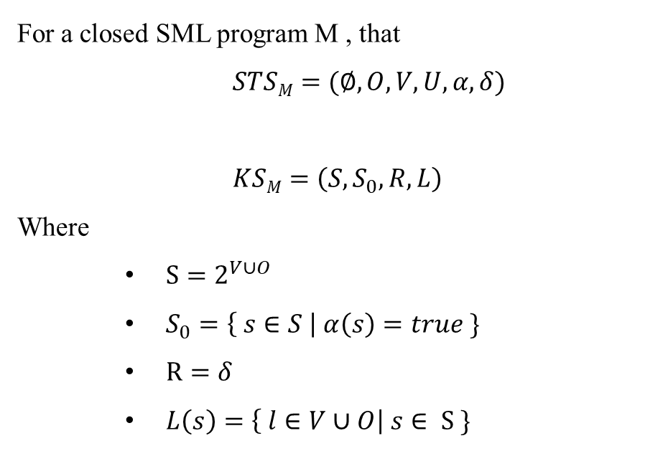
From SML Programs to Kripke Structures
For a closed SML program M , that
$STSM=(∅,O,V,U,α,δ)$
$KSM=\left(S,S_{0},R,L\right)$
Where
$S=2^{V∪O}$
$S_{0}=\left\{ s∈S \right| α\left(s\right)=true \}$
$R=δ$
$L\left(s\right)=\left\{ l∈V∪O\right| s∈ S \}$

Slide 15
Simple modeling language (SML)
我们使用符号迁移系统 [ STS symbolic transition system ]来描述SML程序的语义。
STS =（ I，O，V，U，α，δ ）
I，O，V，U是输入，输出，状态和共享变量的有限集合，每个变量也具有相关类型;
α是初始状态： V∪U 。
δ是迁移关系： I ∪ O ∪ V ∪ U ∪ V' ∪ U' ，其中 V' = { s' | s ∈ V } 表示“下一个状态”的集合，U'类似于V'。
私有模块：共享变量的集合为∅。所以 M =（ I，O，V， ∅ ，α，δ ）。
复合模块：假设M是由模块M₁，M₂，...，M_{n} 组成，对应的STSs形式为（ I_{i} ， O_{i} ， V_{i} ， U_{i}，α_{i}，δ_{i} ）其中i = 1, . . . , n. 设β是从M的初始状态声明（不是其组成模块）导出的谓词。令γ为从M的连接声明派生的谓词，作为构成这些声明的每个等式的连接。然后，M的STS是（I，O，V，U，α，δ），其中

Slide 16
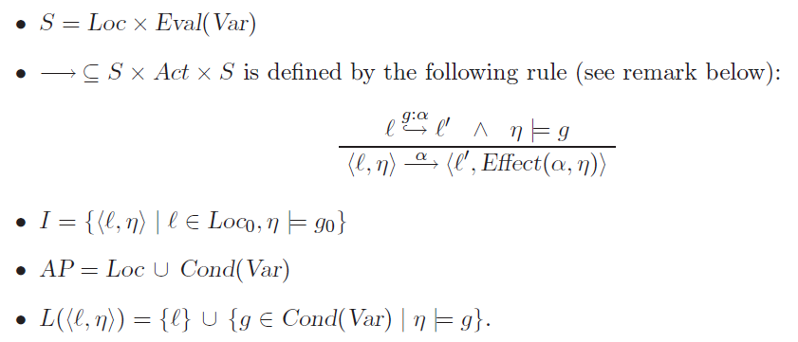
Translation from PG into TS
Definition 2.15. Transition System Semantics of a Program Graph
The transition system TS(PG) of program graph
PG = (Loc, Act,Effect, $→, Loc0, g0)
over set Var of variables is the tuple (S, Act,−→, I,AP, L) where

Slide 17
S=Loc*Eval(Var)
Loc={start,select}
nsoda={0,1,2} 共 |S|= 2*3*3=18种状态
nbeer={0,1,2}

Slide 18
I= {⟨ℓ, η⟩ | ℓ ∈ Loc0, η |= g0}
Initial state: {start,nsoda=2^nbeer=2}

Slide 19
True g:coin
nsoda>0 g:sget
start
select
True g:refill
nbeer>0 g:bget
nsoda=0^nbeer=0 g:ret_coin
PG

Slide 20
AP = Loc ∪ Cond(Var)
AP={start,select,nsoda=2^nbeer=2,
nsoda=1^nbeer=2, nsoda=2^nbeer=1,
nsoda=0^nbeer=2,nsoda=2^nbeer=0,
nsoda=0^nbeer=2,nsoda=0^nbeer=1,
nsoda=1^nbeer=0, nsoda=0^nbeer=0}

Slide 21
L(⟨ℓ, η⟩) = {ℓ} ∪ {g ∈ Cond(Var) | η |= g}.
L(s1)= {start, nsoda=2^nbeer=2}、 L(s2)= {select, nsoda=2^ nbeer=2}
L(s3)= {start, nsoda=1^nbeer=2}、 L(s4)= {select, nsoda=1^nbeer=2}
L(s5)= {start, nsoda=2^nbeer=1}、 L(s6)= {select, nsoda=2^nbeer=1}
L(s7)= {start, nsoda=0^nbeer=2}、 L(s8)= {select, nsoda=0^nbeer=2}
L(s9)= {start, nsoda=2^nbeer=0}、 L(s10)= {select, nsoda=2^nbeer=0}
L(s11)= {start, nsoda=1^nbeer=1}、 L(s12)= {select, nsoda=1^nbeer=1}
L(s13)= {start, nsoda=0^nbeer=1}、 L(s14)= {select, nsoda=0^nbeer=1}
L(s15)= {start, nsoda=1^nbeer=0}、 L(s16)= {select, nsoda=1^nbeer=0}
L(s17)= {start, nsoda=0^nbeer=0}、 L(s18)= {select, nsoda=0^nbeer=0}

Slide 22
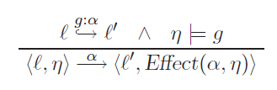
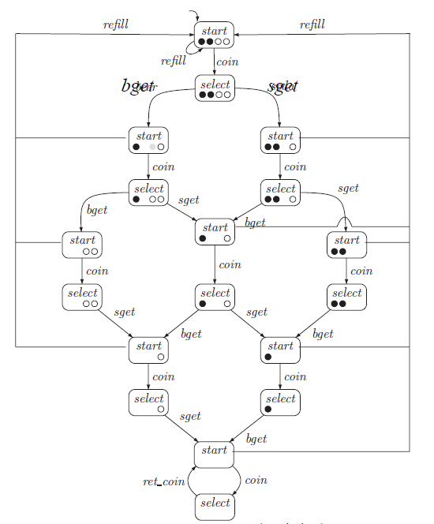
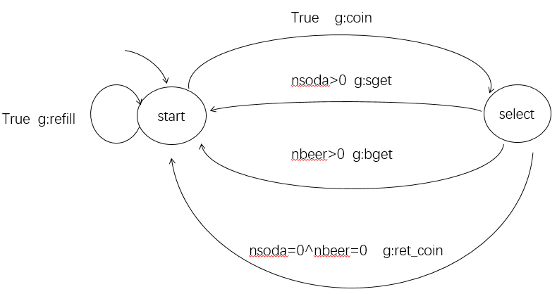
PG
TS

